Slide 1


http://www.comp.nus.edu.sg/~cs2100/
Recitation-4
MIPS – 3 & ISA
L9 and L10 videos
Prabhu NATARAJAN

Slide 2
Agenda
MIPS Revision
Quiz questions
Slido Q/A
Discussion

Slide 3
REVISION

Slide 4
1. Overview and Motivation
Recap: Assembly instructions will be translated to machine code for actual execution
This section shows how to translate MIPS assembly code into binary patterns
Explains some of the “strange facts” from earlier:
Why is immediate limited to 16 bits?
Why is shift amount only 5 bits?
etc.
Prepare us to “build” a MIPS processor in later lectures!

Slide 5
2. MIPS Encoding: Basics
Each MIPS instruction has a fixed-length of 32 bits
➔ All relevant information for an operation must be encoded with these bits!
Additional challenge:
To reduce the complexity of processor design, the instruction encodings should be as regular as possible
➔ Small number of formats, i.e. as few variations as possible

Slide 6
3. MIPS Instruction Classification
Instructions are classified according to their operands:
➔ Instructions with same operand types have same encoding
R-format (Register format: op $r1, $r2, $r3)
Instructions which use 2 source registers and 1 destination register
e.g. add, sub, and, or, nor, slt, etc
I-format (Immediate format: op $r1, $r2, Immd)
e.g. addi, andi, ori, slti, lw, sw, beq, bne, etc.
J-format (Jump format: op Immd)
j instruction uses only one immediate value
Instructions which use 1 source register, 1 immediate value and 1 destination register
Special cases: srl, sll, etc.

Slide 7
4. MIPS Registers (Recap)
For simplicity, register numbers ($0, $1, …, $31) will be used in examples here instead of register names
Name | Register number | Usage
$zero | 0 | Constant value 0
$v0-$v1 | 2-3 | Values for results and expression evaluation
$a0-$a3 | 4-7 | Arguments
$t0-$t7 | 8-15 | Temporaries
$s0-$s7 | 16-23 | Program variables
Name | Register number | Usage
$t8-$t9 | 24-25 | More temporaries
$gp | 28 | Global pointer
$sp | 29 | Stack pointer
$fp | 30 | Frame pointer
$ra | 31 | Return address
$at (register 1) is reserved for the assembler.
$k0-$k1 (registers 26-27) are reserved for the operation system.

Slide 8
5. R-Format (1/2)
Define fields with the following number of bits each:
6 + 5 + 5 + 5 + 5 + 6 = 32 bits
6
5
5
5
5
6
Each field has a name:
opcode
rs
rt
rd
shamt
funct
Each field is an independent 5- or 6-bit unsigned integer
A 5-bit field can represent any number 0 – 31
A 6-bit field can represent any number 0 – 63

Slide 9
5.1 R-Format: Example (1/3)
MIPS instruction
add $8, $9, $10
R-Format Fields | Value | Remarks
opcode | 0 | (textbook pg 94 - 101)
funct | 32 | (textbook pg 94 - 101)
rd | 8 | (destination register)
rs | 9 | (first operand)
rt | 10 | (second operand)
shamt | 0 | (not a shift instruction)

Slide 10

5.1 R-Format: Example (2/3)
MIPS instruction
add $8, $9, $10
Note the ordering of the 3 registers
Field representation in decimal:
opcode
rs
rt
rd
shamt
funct
0
9
10
8
0
32
Field representation in binary:
000000
01001
01010
01000
00000
100000
Split into 4-bit groups for hexadecimal conversion:
0000
0001
0010
1010
0100
0000
0010
0000
0₁₆
1₁₆
2₁₆
A₁₆
4₁₆
0₁₆
2₁₆
0₁₆

Slide 11
5.1 R-Format: Example (3/3)
MIPS instruction
sll $8, $9, 4
Note the placement of the source register
Field representation in decimal:
opcode
rs
rt
rd
shamt
funct
0
0
9
8
4
0
Field representation in binary:
000000
00000
01001
01000
00100
000000
Split into 4-bit groups for hexadecimal conversion:
0000
0000
0000
1001
0100
0001
0000
0000
0₁₆
0₁₆
0₁₆
9₁₆
4₁₆
1₁₆
0₁₆
0₁₆

Slide 12
6. I-format (2/4)
Define fields with the following number of bits each:
6 + 5 + 5 + 16 = 32 bits
6
5
5
16
Again, each field has a name:
opcode
rs
rt
immediate
Only one field is inconsistent with R-format.
opcode, rs, and rt are still in the same locations.

Slide 13
6.1 I-format: Example (1/2)
MIPS instruction
addi $21, $22, -50
I-Format Fields | Value | Remarks
opcode | 8 | (textbook pg 94 - 101)
rs | 22 | (the only source register)
rt | 21 | (target register)
immediate | -50 | (in base 10)

Slide 14
6.1 I-format: Example (2/2)
MIPS instruction
addi $21, $22, -50
Field representation in decimal:
8
22
21
-50
Field representation in binary:
001000
10110
10101
1111111111001110
Hexadecimal representation of instruction:
2 2 D 5 F F C E₁₆

Slide 15
6.2 Try It Yourself #2
MIPS instruction
lw $9, 12($8)
Field representation in decimal:
opcode
rs
rt
immediate
35
8
9
12
Field representation in binary:
100011
01000
01001
0000000000001100
Hexadecimal representation of instruction:
8 D 0 9 0 0 0 C₁₆


Slide 16
6.4 Branch: PC-Relative Addressing (5/5)
Branch calculation:
Observations:
immediate field specifies the number of words to jump, which is the same as the number of instructions to “skip over”
immediate field can be positive or negative
Due to hardware design, add immediate to (PC+4), not to PC (more in later topic)
If the branch is not taken:
PC = PC + 4
(PC + 4 is address of next instruction)
If the branch is taken:
PC = (PC + 4) + (immediate × 4)

Slide 17
6.5 Branch: Example (1/3)
Loop: beq $9, $0, End # rlt addr: 0
add $8, $8, $10 # rlt addr: 4
addi $9, $9, -1 # rlt addr: 8
j Loop # rlt addr: 12
End: # rlt addr: 16
beq is an I-Format instruction ➔
I-Format Fields | Value | Remarks
opcode | 4
rs | 9 | (first operand)
rt | 0 | (second operand)
immediate | ??? | (in base 10)

Slide 18
6.5 Branch: Example (2/3)
Loop: beq $9, $0, End # rlt addr: 0
add $8, $8, $10 # rlt addr: 4
addi $9, $9, -1 # rlt addr: 8
j Loop # rlt addr: 12
End: # rlt addr: 16
immediate field:
Number of instructions to add to (or subtract from) the PC, starting at the instruction following the branch
In beq case, immediate = 3
End = (PC + 4) + (immediate × 4)

Slide 19
6.5 Branch: Example (3/3)
Loop: beq $9, $0, End # rlt addr: 0
add $8, $8, $10 # rlt addr: 4
addi $9, $9, -1 # rlt addr: 8
j Loop # rlt addr: 12
End: # rlt addr: 16
Field representation in decimal:
opcode
rs
rt
immediate
4
9
0
3
Field representation in binary:
000100
01001
00000
0000000000000011

Slide 20
6.6 Try It Yourself #3
Loop: beq $9, $0, End # rlt addr: 0
add $8, $8, $10 # rlt addr: 4
addi $9, $9, -1 # rlt addr: 8
beq $0, $0, Loop # rlt addr: 12
End: # rlt addr: 16
What would be the immediate value for the second beq instruction?
Answer: – 4


Slide 21
7. J-Format (2/5)
Define fields of the following number of bits each:
6 bits
26 bits
As usual, each field has a name:
opcode
target address
Keep opcode field identical to R-format and I-format for consistency
Combine all other fields to make room for larger target address

Slide 22
7. J-Format (3/5)
We can only specify 26 bits of 32-bit address
Optimization:
Just like with branches, jumps will only jump to word-aligned addresses, so last two bits are always 00
So, let’s assume the address ends with ’00’ and leave them out
➔ Now we can specify 28 bits of 32-bit address

Slide 23
7. J-Format (4/5)
Where do we get the other 4 bits?
MIPS choose to take the 4 most significant bits from PC+4 (the next instruction after the jump instruction)
➔ This means that we cannot jump to anywhere in memory, but it should be sufficient most of the time
Question:
What is the maximum jump range?
256MB boundary
Special instruction if the program straddles 256MB boundary
Look up jr instruction if you are interested
Target address is specified through a register

Slide 24
7.1 J-Format: Example
Loop: beq $9, $0, End # addr: 8
add $8, $8, $10 # addr: 12
addi $9, $9, -1 # addr: 16
j Loop # addr: 20
End: # addr: 24
jump target
PC
PC
0000………………………..10100
Check your understanding by constructing the new PC value
Address to jump to
0000………………………..01000
immediate =2 (26 bits)
opcode
target address
000010
00000000000000000000000010

Slide 25
3.5 Fixed Length Instructions: Encoding (1/4)
Fixed length instruction presents a much more interesting challenge:
Q: How to fit multiple sets of instruction types into same (limited) number of bits?
A: Work with the most constrained instruction types first
Expanding Opcode scheme:
The opcode has variable lengths for different instructions.
A good way to maximize the instruction bits.

Slide 26
3.5 Fixed Length Instructions: Encoding (2/4)
Example:
16-bit fixed length instructions, with 2 types of instructions
Type-A: 2 operands, each operand is 5-bit
Type-B: 1 operand of 5-bit
First Attempt:
Fixed length Opcode
Problem:
Wasted bits in Type-B instructions
Maximum total number of instructions is 2⁶ or 64.
opcode
operand
operand
Type-A
6 bits
5 bits
5 bits
opcode
operand
unused
Type-B
6 bits
5 bits
5 bits

Slide 27
3.5 Fixed Length Instructions: Encoding (3/4)
Use expanding opcode scheme:
Extend the opcode for type-B instructions to 11 bits
➔ No wasted bits and result in a larger instruction set
opcode
operand
operand
Second Attempt:
Expanding Opcode
Type-A
6 bits
5 bits
5 bits
opcode
operand
Type-B
11 bits
5 bits
Questions:
How do we distinguish between Type-A and Type-B?
How many different instructions do we really have?

Slide 28
3.5 Fixed Length Instructions: Encoding (4/4)
What is the maximum number of instructions?
opcode
operand
operand
Answer:
1 + (2⁶ –1) × 2⁵
= 1 + 63×32
= 2017
Type-A
6 bits
5 bits
5 bits
opcode
operand
Type-B
11 bits
5 bits
Reasoning:
For every 6-bit prefix (front-part) given to Type-B, we get 2⁵ unique patterns, e.g. [111111]XXXXX
So, we should minimize Type-A instruction and give as many 6-bit prefixes as possible to Type-B
➔ 1 Type-A instruction, 2⁶ – 1 prefixes for Type-B

Slide 29
3.5 Expanding Opcode: Another Example
Design an expanding opcode for the following to be encoded in a 36-bit instruction format. An address takes up 15 bits and a register number 3 bits.
7 instructions with two addresses and one register number.
500 instructions with one address and one register number.
50 instructions with no address or register.
3 bits
15 bits
15 bits
3 bits
One possible answer:
000 → 110
address
address
register
opcode
111
000000 + 9 bits
address
register
opcode
000001
111
:
+ 9 0s
unused
unused
110010
opcode

Slide 30
Past Midterm/Exam Questions (1/2)
A certain machine has 12-bit instructions and 4-bit addresses. Some instructions have one address and others have two. Both types of instructions exist in the machine.
What is the maximum number of instructions with one address?
15
16
240
256
None of the above
Answer: (c)


Slide 31
Past Midterm/Exam Questions (2/2)
A certain machine has 12-bit instructions and 4-bit addresses. Some instructions have one address and others have two. Both types of instructions exist in the machine.
What is the minimum total number of instructions, assuming the encoding space is completely utilized (that is, no more instructions can be accommodated)?
31
32
48
256
None of the above
Answer: (a)


Slide 32
quiz solution

Slide 33
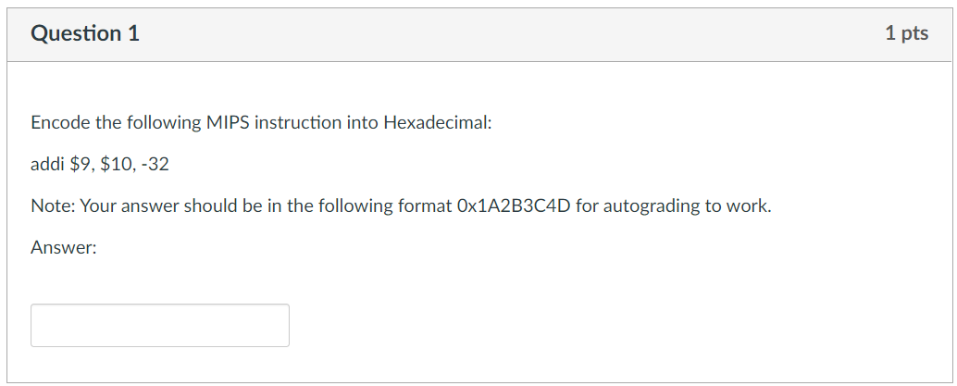
Week-4 MIPS

Slide 34

Week-4 MIPS
rt
rs
opcode
rs
rt
immediate
001000
01010
01001
1111 1111 1110 0000
-32 = -(0b0000 0000 0010 0000_{2s})
= 0b1111 1111 1110 0000_{2s}
Encoding = 0b0010 0001 0100 1001 1111 1111 1110 0000
= 0x2149FFE0

Slide 35
Week-4 MIPS
0x2149FFE0

Slide 36
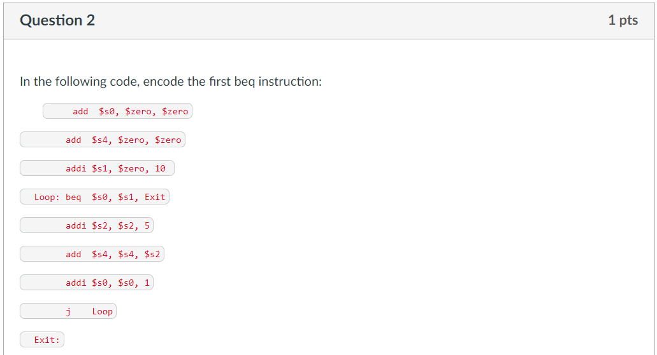
Week-4 MIPS
4 instructions

Slide 37

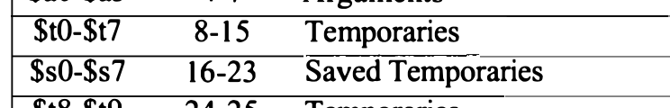
Week-4 MIPS
rs
rt
$s0 = 16, $s1=17
opcode
rs
rt
immediate
000100
10000
10001
0000 0000 0000 0100
Encoding: 0b000100 10000 10001 0000 0000 0000 0100
= 0b0001 0010 0001 0001 0000 0000 0000 0100
= 0x12110004

Slide 38
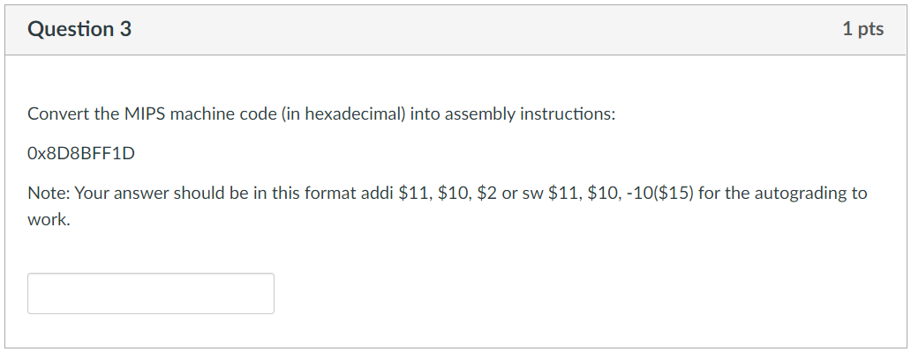
Week-4 MIPS

Slide 39

Week-4 MIPS
= 0b1000 1101 1000 1011 1111 1111 0001 1101
= 0b100011 01 1000 1011 1111 1111 0001 1101
Opcode = 0x23 = lw
opcode
rs
rt
immediate
0b100011 01100 01011 1111 1111 0001 1101
= lw $11, $12, -227
= lw $11, -227($12)

Slide 40
Week-4 MIPS
lw $12, -227($11)

Slide 41
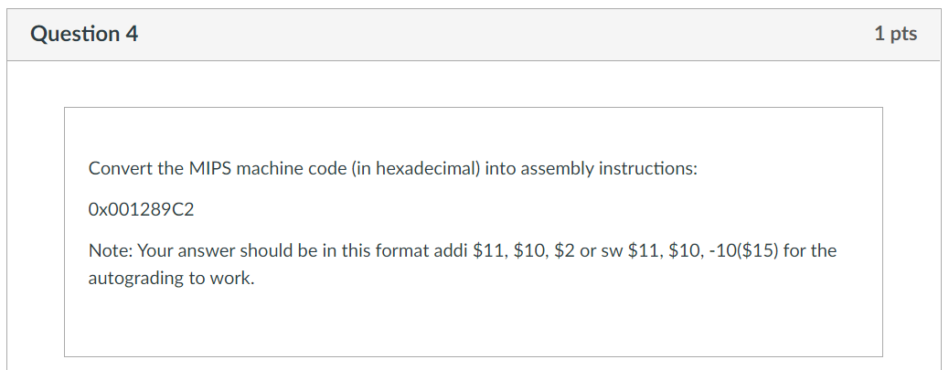
Week-4 MIPS

Slide 42

Week-4 MIPS
= 0b0000 0000 0001 0010 1000 1001 1100 0010
= 0b000000 00 0001 0010 1000 1001 1100 0010
Opcode = 0x00 = R-Type
funct = 0b000010 = 0x2 = srl
= 0b000000 00000 10010 10001 00111 000010
srl $17, $18, 7

Slide 43
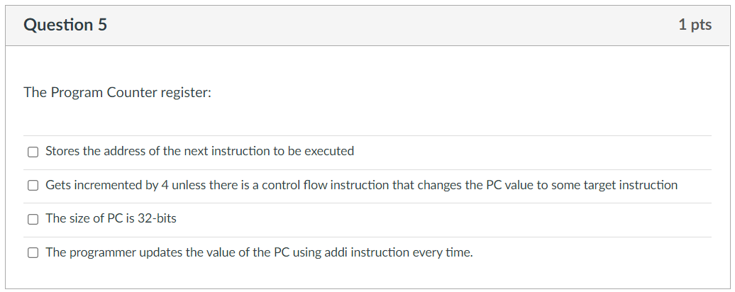
Week-4 MIPS

Slide 44
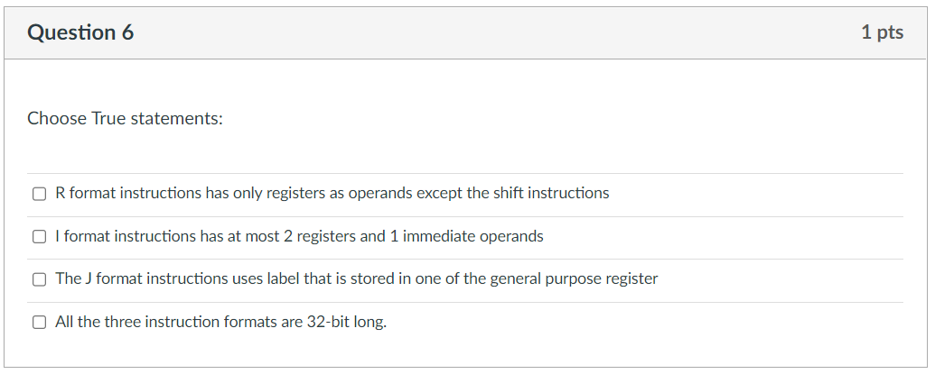
Week-4 MIPS

Slide 45
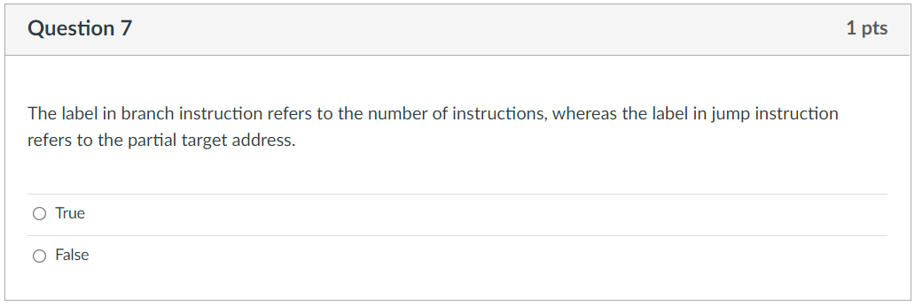
Week-4 MIPS

Slide 46
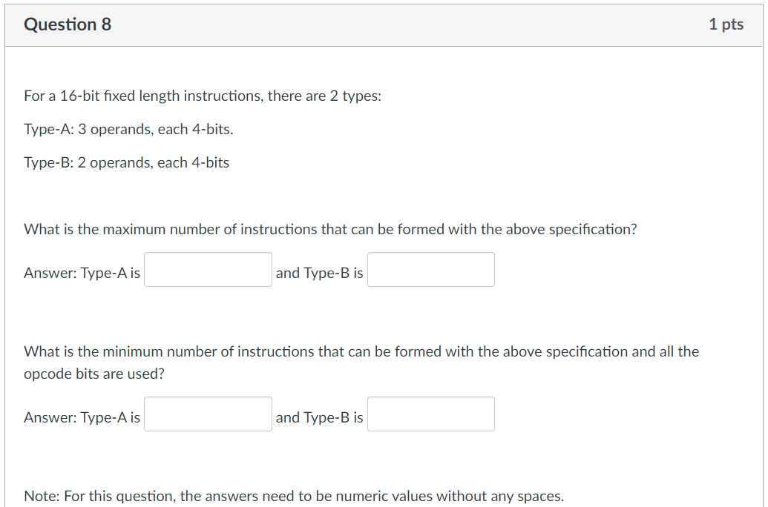
Week-4 MIPS

Slide 47
Week-4 MIPS
Type A:
Total = 16 bits. 3 operands = 3 x 4 = 12 bits.
Opcode = 4 bits
Type B:
Total = 16 bits, 2 operands = 2 x 8 = 8 bits.
Opcode = 8 bits.
Calculating maximum:
Maximize number of opcodes for Type B.
Set aside 0b1111 xxxx for Type A.
# of opcodes for Type B = 256 – 16 = 240 opcodes.
# of opcodes for Type A = 1
Total = 241 opcodes.

Slide 48
Week-4 MIPS
1
240

Slide 49
Week-4 MIPS
Type A:
Total = 16 bits. 3 operands = 3 x 4 = 12 bits.
Opcode = 4 bits
Type B:
Total = 16 bits, 2 operands = 2 x 8 = 8 bits.
Opcode = 8 bits.
Calculating minimum:
Maximize number of opcodes for Type A:
Set aside 0b1111 for opcodes for Type B.
This gives us 15 opcodes for Type A
For type B we have 0b1111xxxx: This gives us 16 Type B opcodes.
Total = 15 + 16 = 31.

Slide 50
Week-4 MIPS
1
240
15
16

Slide 51
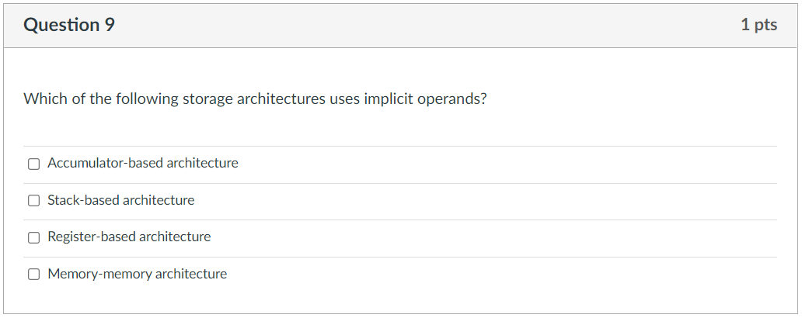
Week-4 MIPS

Slide 52
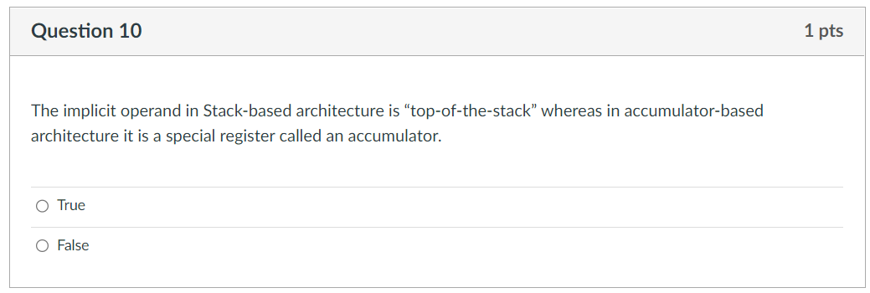
Week-4 MIPS

Slide 53
slido questions

Slide 54
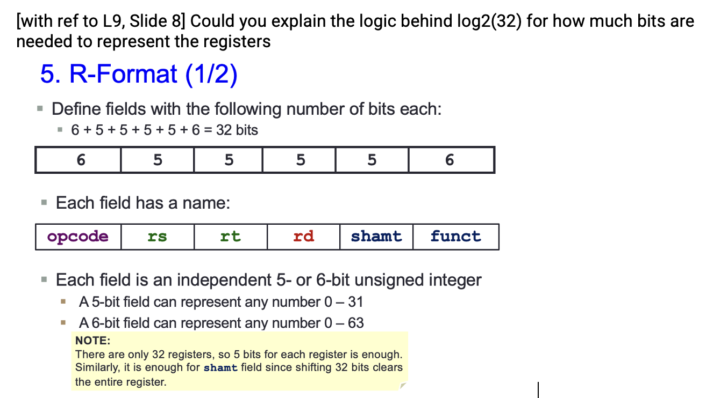
MIPS Instruction Formats

Slide 55
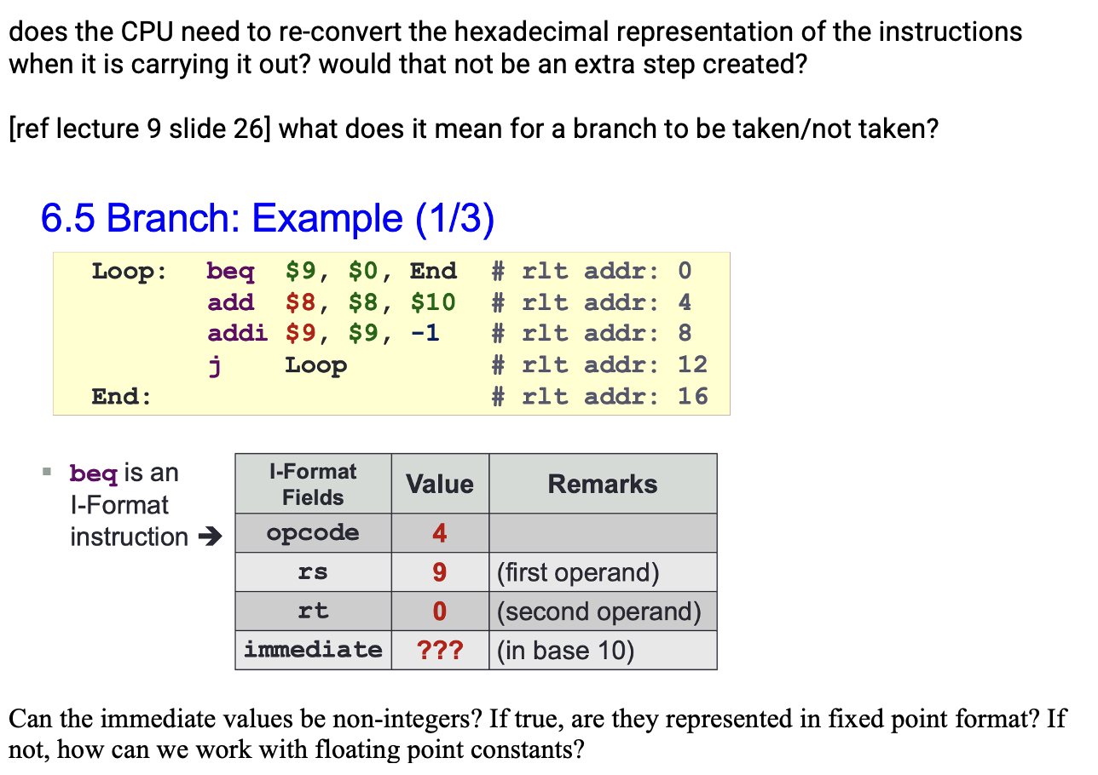
MIPS Instruction Formats

Slide 56
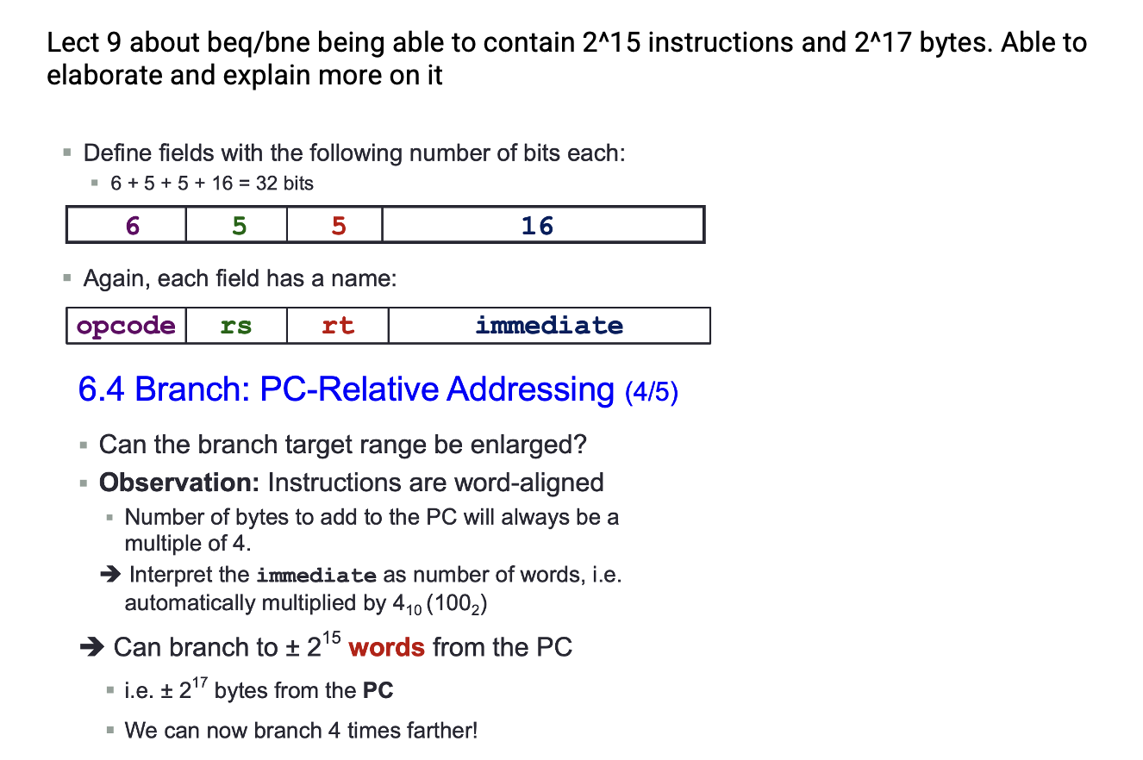
MIPS Instruction Formats

Slide 57
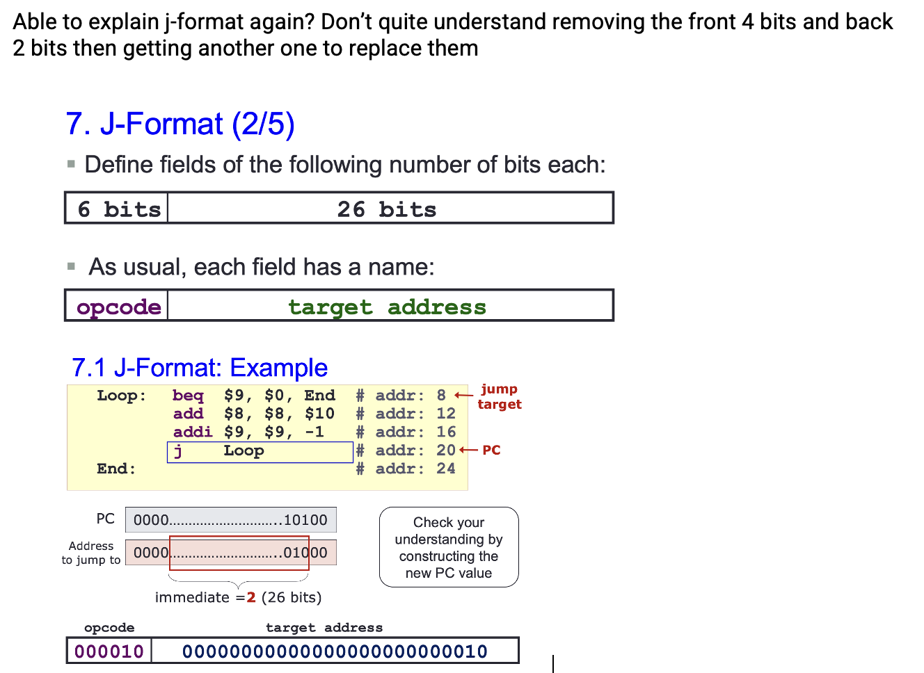
MIPS Instruction Formats

Slide 58
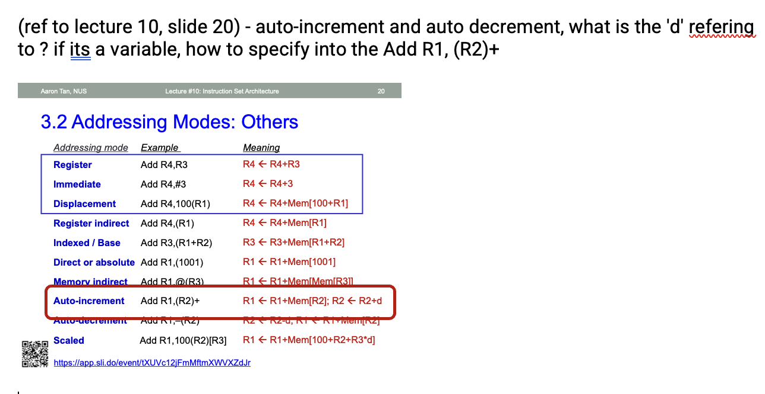
Addressing Modes

Slide 59
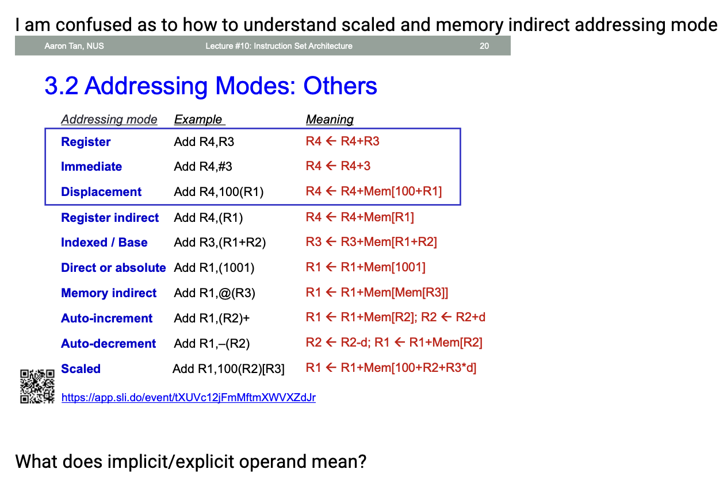
Addressing Modes

Slide 60
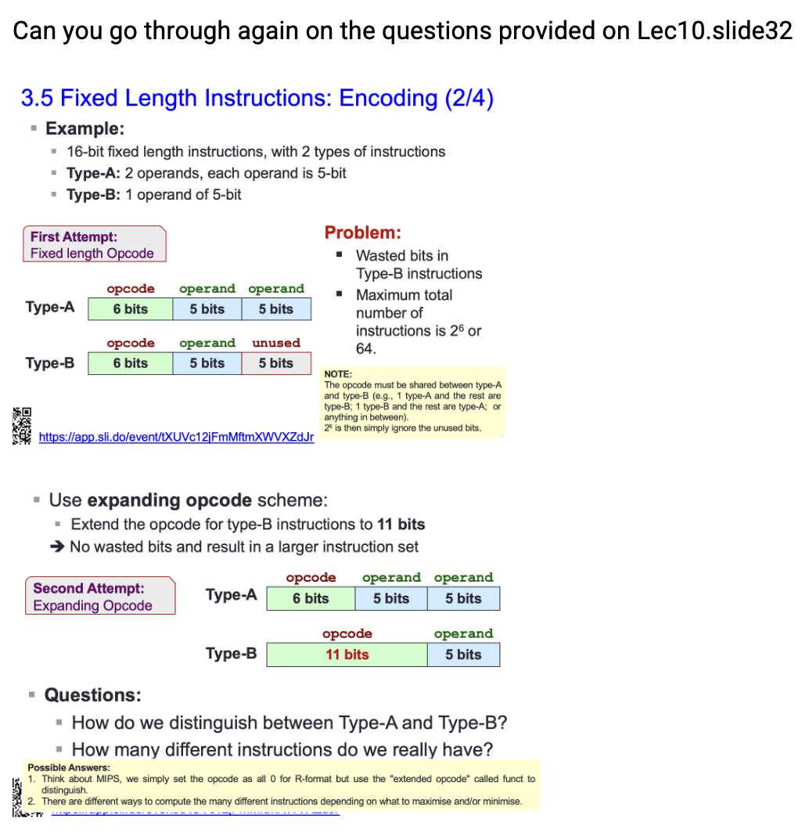
Expanding Opcodes

Slide 61
End of File

